Slide 1
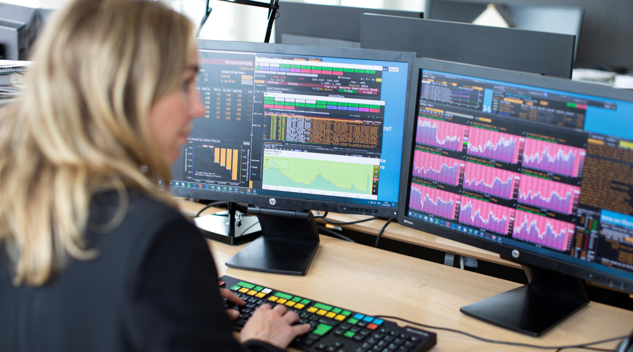
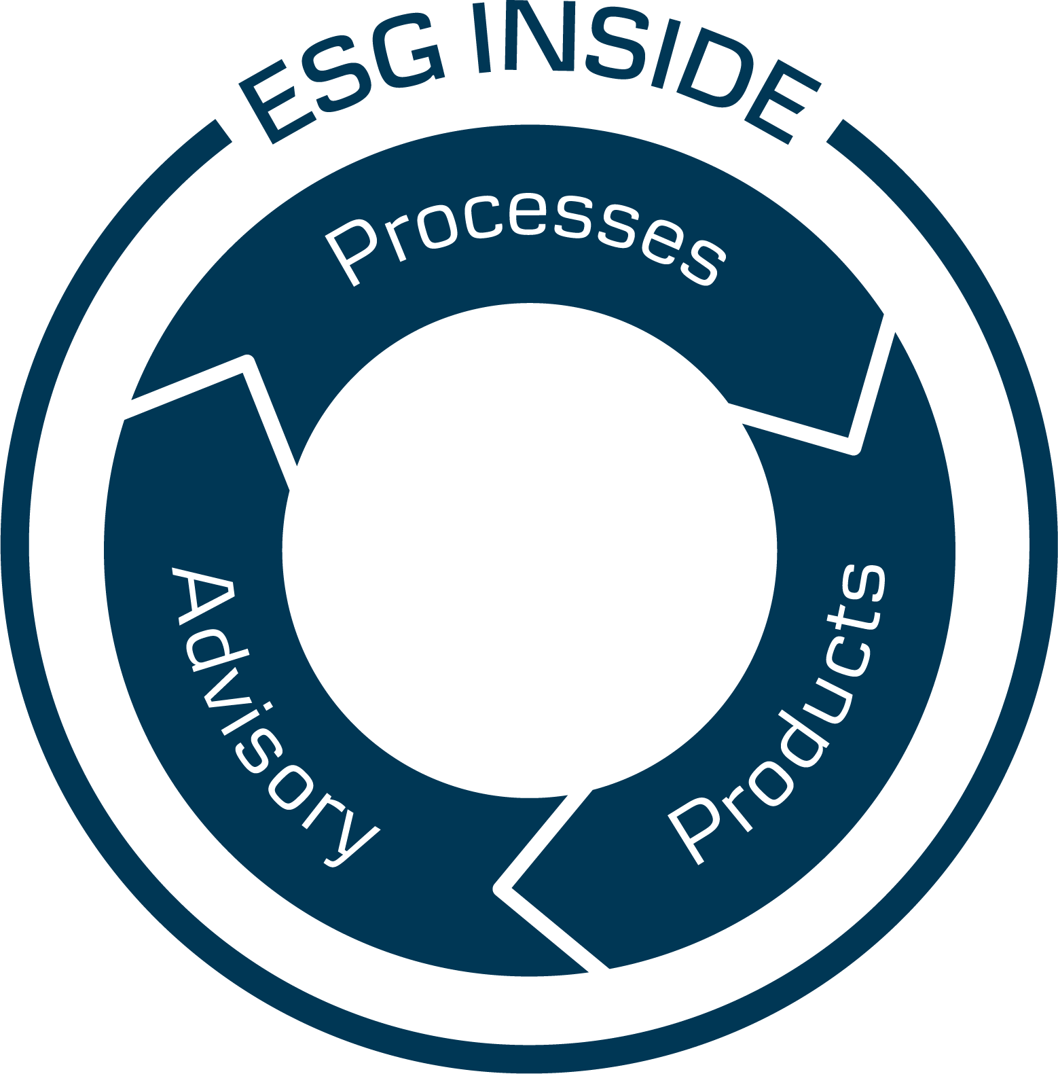
Active Ownership Report: H1 2020 Danske Invest
Danske Invest Index
Danske Invest Select
August 2020

Slide 2
Active Ownership Report: H1 2020
The two parts of the report
When customers entrust us with their assets and savings, it is our duty to serve their interests by providing investment solutions with the goal to deliver competitive and long-term performance. Our firm commitment to Sustainable Investment with ESG Inside is an integral part of this duty.
ESG Inside is about making better-informed investment decisions – addressing issues of risk, problems, and dilemmas, and influencing portfolio companies through active ownership to contribute to a positive outcome.
Active ownership – through direct dialogue and voting at the annual general meetings – is an important part of our ability to create long-term value to the companies we invest in and to our customers.
We believe it is more responsible to address material ESG matters as investors rather than refraining from investing when issues of concern arise, leaving the problem to someone else to solve. Our portfolio managers are the change agents who can impact companies to manage risks and opportunities.
The aim of our Active Ownership Report covering two parts ‘Engagement Report’ and ‘Voting Report’ is to provide our customers and stakeholders with regular updates on our progress and results.
Part 1:
Engagement Report
Part 2:
Voting Report

Slide 3
Where to get additional information
Sustainable Investment Policy
Click here
Active Ownership Instruction
Click here
Voting Guidelines
Click here*
Our Sustainable Investment Journey
Click here
Active Ownership Stories
Click here
Proxy Voting Dashboard
Click here
* Will be published shortly

Slide 4
Active Ownership Report: H1 2020 Part 1: Engagement Report
This presentation is intended to be used as marketing material as defined by the European Directive 2014/65/EU dated 15 May 2014 (MiFID II) in Austria, Belgium, Denmark, Finland, France, Germany, Luxembourg, the Netherlands, Norway, Sweden, Switzerland and the United Kingdom.

Slide 5
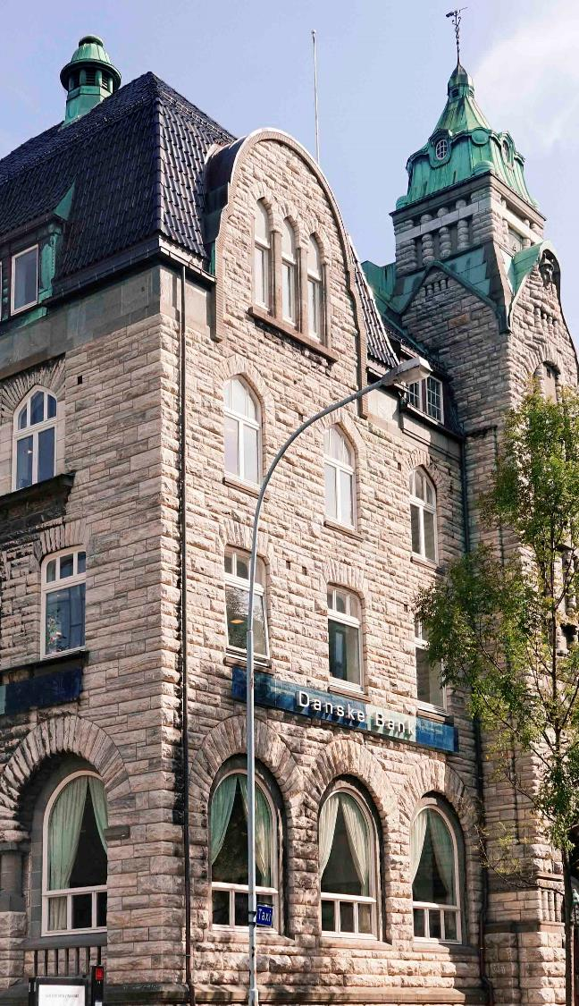
Engagement Report introduction
We believe that fund-manager-driven dialogue with companies is the most effective as the investment teams are the experts of their respective strategies and portfolios, and tasked with the buy/sell decision.
Our investment teams engage on a regular basis with companies on material ESG matters to understand their risks and opportunities, and to support their growth and development.
We log and monitor company dialogue and progress to ensure a structured engagement process.

Slide 6
In H1 2020, we have had the following engagement activities
Companies
237
Country domiciles
32
ESG engagement topics
90
Interactions
348

Slide 7
Top 10 industries most engaged with during H1 2020 Number of companies per industry (Sector in bracket)
Companies
237
Note: The Bloomberg Industry Classification Systems (BICS) is used for sector classification

Slide 8
Engagement with companies domiciled in 32 countries
Country domiciles
32

Slide 9
Split between ESG engagement themes
ESG engagement topics
90

Slide 10
Split between ESG engagement themes across regions
ESG engagement topics
90
E
S
G
Nordics
Rest of the world
Eastern Europe
Western & Southern Europe

Slide 11
90 ESG engagements topics have been addressed and discussed
ESG engagement topics
90
E
S
G
Agriculture
Share Buybacks
Green Financing
Data Privacy
Materials Sourcing & Efficiency
Data Security
Responsible Drinking
Sustainable Products
Energy Efficiency
Research & Development
Digitalisation
Compliance Procedures
Digitalisation
Customer Privacy
Air Quality
Sustainability Targets
Ecological Impacts
Physical Impacts Of Climate Change
Restructuring
Energy Consumption
Access & Affordability
Political Risk
SDGs
Product Quality & Safety
Competence
Employee Retention
Board Composition
Executive Composition
Sustainable Transports
Future Fit
Dividends
Water & Wastewater Management
Product Development
Anti-Corruption Issues & Handling
Critical Incident Risk Management
Energy Transformation
Customer Welfare
Sustainability Strategy
Food Safety
Environmental Incidents
Financial Accessibility
Regulatory Compliance
Environmental Regulation
AML Issues & Handling
Capital Structure
Environmental Supply Chain
Employee Engagement, Diversity & Inclusion
Human Rights & Community Relations
Ownership Structure
Labor Standards/Practices
Circular Economy
Accounting
Incentive Programs
Environmental Issues
Plastic/Recycling Products
SDGs
Sustainability Integration & Reporting
Indigenous Rights
Systemic Risk Management
Executive Compensation
M&A
Customer Education
Technology Disruption
Sustainable Shipping
Climate Neutrality
Sustainability Certificates
Overboarding
International Norms & Principals
Regulations
GHG Emissions
Animal Welfare
Board Leadership
Product Design & Lifecycle Management
Business Model Resilience
Personnel Turnover
Corporate Behavior
Waste & Hazardous Materials Management
Palm Oil Production
Employee Health & Safety
Anti-Trust Issues & Competitive Behavior
Energy Management
Corporate Governance
Quality Management
Green Buildings
Business Ethics
ESG Issues In Fish Farming
Decent Work & Economic Growth
ESG Integration
Selling Practices & Product Labeling
SDGs
Sustainability Ratings
Supply Chain Management

Slide 12
Top 7 ESG engagement topics across the E, S, and G theme
ESG engagement topics
90
E
S
G
Rank | Topic | Count
1 | GHG Emissions | 53
2 | Energy Efficiency | 39
3 | Energy Transformation | 32
4 | Green Financing | 25
5 | Digitalisation | 21
6 | Sustainable Products | 21
7 | Circular Economy | 20
Rank | Topic | Count
1 | Employee Health & Safety | 43
2 | Supply Chain Management | 28
3 | Business Model Resilience | 25
 | Access & Affordability | 19
 | Customer Welfare | 16
 | Product Quality & Safety | 15
 | Product Design & Lifecycle Management | 13
Rank | Topic | Count
1 | Dividends | 30
2 | Capital Structure | 20
3 | ESG Integration | 18
4 | M&A | 17
5 | Restructuring | 15
6 | Business Ethics | 12
7 | Corporate Governance | 12
1
1
1
2
2
2
3
3
3
4
4
4
5
5
5
6
6
6
7
7
7

Slide 13
Top 3 among ESG engagement topics: GHG Emissions; Employee Health & Safety; and Energy Efficiency
ESG engagement topics
90
E
S
G

Slide 14
Top 10 and engagement interactions across Nordic countries
Interactions
348
Rank | Country | Count
 | Sweden | 91
 | Norway | 50
 | Denmark | 35
 | United Kingdom | 23
 | Germany | 21
 | Finland | 20
 | United States | 20
 | France | 13
 | Netherlands | 12
 | Russia | 11
1
2
3
4
5
20
6
50
7
8
91
Region | Count
Nordics | 200
Western & Southern Europe | 103
Rest of the world | 29
Eastern Europe | 16
9
10
35

Slide 15
Most commonly addressed ESG topics across geography
Interactions
348
Ownership
Structure
Dividends
Employee Health
& Safety
Customer
Welfare
GHG Emissions
Executive Compensation
Dividends
Digitalisation
ESG Integration
GHG Emissions
Energy Efficiency
Employee Health
& Safety
Energy Efficiency
GHG Emissions
ESG
Integration
Green
Financing
Sustainable
Products
Employee Health
& Safety
Employee Health
& Safety
Regulations
Energy
Consumption

Slide 16
Company interactions are mainly with one-to-one and with CEO
Interactions
348
Type of meeting
Share of meetings by level of participants

Slide 17
Engagement examples: GHG Emissions
Topic addressed
in the following countries
53 engagements
Among the 348 total engagements focused on GHG Emissions.
GHG Emissions is the first most common topic for our portfolio managers to engage with companies on during H1 2020. GHG Emissions are emissions into earth’s atmosphere of any type of various gases contributing to the greenhouse effect.
Company Example
Sector: Basic Materials
“Discussion around company's efforts to lower scope 1&2 emissions through more renewable energy.”
Sector: Utilities
“Discussed hydrogen opportunity and potential place for green hydrogen in the future energy mix.”
Sector: Energy
“Company’s adoption to net zero emission target and discussion about how facilitate energy transformation to lower carbon energy.”
GHG Emissions
Other topics

Slide 18
Engagement examples: Employee Health & Safety
Topic addressed
in the following countries
43 engagements
Among the 348 total engagements focused on Employee Health & Safety.
Employee Health & Safety is the second most common topic for our portfolio managers to engage with companies on during H1 2020. Employee Health & Safety focuses on creating and maintaining safe and healthy workplace environment that is free of accidents, injuries, fatalities, and illness.
Company Example
Sector: Consumer, Non-Cyclical
“Safety for workers during Covid-19.”
Sector: Consumer, Non-Cyclical
“Company’s approach to employee safety.”
Sector: Financial
“Covid-19 impact on business.”
Employee Health & Safety
Other topics

Slide 19
Engagement examples: Energy Efficiency
Topic addressed
in the following countries
39 engagements
Among the 348 total engagements focused on Energy Efficiency.
Energy Efficiency is the third most common topic for our portfolio managers to engage with companies on during H1 2020. Energy Efficiency means using less energy to perform the same task –thus limiting energy waste. It is the cheapest and often the most immediate way in order to reduce the use of fossil fuels.
Company Example
Sector: Energy
“Discussed about company’s energy transition strategy.”
Sector: Basic materials
“Company’s CO2 reductions.”
Sector: Industrial
“Discussed about company’s sustainability targets to reduce CO2 emissions.”
Energy Efficiency
Other topics

Slide 20
Sovereigns: We have had 5 engagements with 4 governmental entities

Slide 21
Sovereigns: In total, have 10 topics been discussed
Monetary policies
Green
Financing
Fiscal issues
Indigenous Rights

Slide 22
Active Ownership Report: H1 2020 Part 2: Voting Report
This presentation is intended to be used as marketing material as defined by the European Directive 2014/65/EU dated 15 May 2014 (MiFID II) in Austria, Belgium, Denmark, Finland, France, Germany, Luxembourg, the Netherlands, Norway, Sweden, Switzerland and the United Kingdom.

Slide 23
Engagement Report introduction
The annual general meeting is an opportunity to voice our opinion, vote on issues of key importance to the running of a company, and contribute to the good governance of the company.
We exercise the right to vote at annual general meetings of Nordic and European companies where we represent relevant holdings. Unless required by special circumstances, holdings in passively managed funds are not subject to voting activities.
We vote either by ourselves or through a service provider.
We log and publish our voting records.

Slide 24
In H1 2020, we have had the following voting activities
Companies
2 979
Country domiciles
55
Meetings
3 301
Proposals
39 717

Slide 25
Companies
2 979
Top 10 industries most voted during H1 2020 Number of companies per industry (Sector in bracket)
Note: Global Industry Classification Standard (GICS) is used for sector classification

Slide 26
Voting with companies domiciled in 55 countries
Country domiciles
55

Slide 27
We voted primarily at Annual General Meetings (AGM)
Meetings
3 301

Slide 28
Top 10 and voting distribution across Nordic countries
Meetings
3 301
Rank | Country Domicile | Count
 | USA | 1253
 | China | 533
 | Japan | 284
 | Cayman Islands | 104
 | France | 87
 | Taiwan | 80
 | Denmark | 78
 | United Kingdom | 77
 | Germany | 71
 | Canada | 69
1
2
3
4
5
21
6
30
7
8
44
Region | Count
Rest of the world | 2 493
Western & Southern Europe | 608
Nordics | 174
Eastern Europe | 26
9
10
78

Slide 29
We predominantly voted ‘For’ the proposals
Proposals
39 717
39 717 Proposals
90,4% (35 913 proposals)
For
8,6% (3 425 proposals)
Against/Withhold
0,7% (297 proposals)
Abstain
Note: Across all voted proposals, 82 proposals with the type of ‘Advisory Vote on Say on Pay Frequency’ was voted on for one year

Slide 30
We predominantly voted ‘For’ the Management proposals
Proposals
39 717
38 623
Management
proposals
91,2% (35 208 proposals)
For
7,9% (3 051 proposals)
Against/Withhold
0,7% (282 proposals)
Abstain
Note: Across all voted proposals, 82 proposals with the type of ‘Advisory Vote on Say on Pay Frequency’ was voted on for one year

Slide 31
We predominantly voted ‘For’ the Shareholder proposals
Proposals
39 717
1 094
Shareholder
proposals
64,4% (705 proposals)
For
34,2% (374 proposals)
Against/Withhold
1,4% (15 proposals)
Abstain

Slide 32
Voted proposals are mainly Directors-related
Proposals
39 717
Management proposals
A total of 38 623 proposals
Shareholder proposals
A total of 1 094 proposals

Slide 33
Most common voted proposals against Management recommendations
Proposals
39 717

Slide 34
Disclaimer & contact information
This publication has been prepared by Wealth Management — a division of Danske Bank A/S (“Danske Bank”). Danske Bank is under supervision by the Danish Financial Supervisory Authority (Finanstilsynet). This publication has been prepared for information purposes only and it is not to be relied upon as investment, legal, tax, or financial advice. The Reader must consult with his or her professional advisors as to the legal, tax, financial or other matters relevant to the suitability and appropriateness of an investment. It is not an offer or solicitation of any offer to purchase or sell any financial instrument. Whilst reasonable care has been taken to ensure that its contents are fair and true, and not misleading, no representation is made as to its accuracy or completeness and no liability is accepted for any loss arising from reliance on it. We accept no responsibility for the accuracy and/or completeness of any third party information obtained from sources we believe to be reliable but which have not been independently verified. Any reference herein to any financial instrument and/or a particular issuer shall not constitute a recommendation to buy or sell, offer to buy, offer to sell, or a solicitation of an offer to buy or sell any such financial instruments issued by such issuer. Danske Bank (acting on its own behalf or on behalf of other clients), its affiliates or staff, may perform services for, solicit business from, hold long or short positions in, or otherwise be interested in the investments (including derivatives), of any issuer mentioned herein. Neither this document nor any copy of it may be taken or transmitted into the United States of America, its territories or possessions (the ‘United States’) or distributed directly or indirectly in the United States or to any U.S. person (as defined in Regulation S under the U.S Securities Act of 1933, as amended), including any national or resident of the United States, or any corporation, partnership or other entity organised under the laws of the United States. Copyright © Danske Bank A/S. All rights reserved. This publication is protected by copyright and may not be reproduced in whole or in part without permission. Danske Bank Asset Management — a division of Danske Bank A/S Holmens Kanal 2-12 DK-1092 Copenhagen, Denmark Company reg. no.: 61 12 62 28 Tel. +45 45 13 96 00 Fax +45 45 14 98 03 https://danskebank.dk/asset-management

Slide 35
Engagement during H1 2020, by company
Akamai Technologies Inc | BASF SE | DLR Kredit A/S | Grieg Seafood ASA | Kemira Oyj
Akelius Residential Property AB | Bavarian Nordic A/S | DNB ASA | Grupa Kety SA | K-fast Holding AB
Aker BioMarine AS | Baxter International Inc | Dometic Group AB | H Lundbeck A/S | Kinnevik AB
Akzo Nobel NV | BHP Group Ltd | Drilling Co of 1972 A/S/The | Haci Omer Sabanci Holding AS | Knorr-Bremse AG
Allegion plc | BillerudKorsnas AB | DSV PANALPINA A/S | Haldex AB | Kojamo Oyj
Allianz SE | Boston Scientific Corp | E.ON SE | Heimstaden AB | Konecranes Oyj
Alrosa PJSC | BP PLC | Ecolab Inc | Heimstaden Bostad AB | Koninklijke Philips NV
Alstom SA | BW Offshore Ltd | Eli Lilly and Co | Heineken NV | Kungsleden AB
Altice Europe NV | CaixaBank SA | Elisa Oyj | Hennes & Mauritz AB | Leroy Seafood Group ASA
Ambea AB | Castellum AB | Elkem ASA | Hexagon AB | Liberty Global PLC
Amgen Inc | Caverion Oyj | Ellevio AB | Hoist Finance AB | Lifco AB
Anheuser-Busch InBev SA/NV | CD Projekt SA | Eltel AB | Huhtamaki Oyj | Link Net Tbk PT
Antofagasta PLC | CEZ AS | Enel SpA | Husqvarna AB | L'Oreal SA
AP Moller - Maersk A/S | Chr Hansen Holding A/S | Epiroc AB | Iberdrola SA | Magnit PJSC
Arjo AB | Cie Generale des Etablissements Michelin SCA | EQT AB | ICA Gruppen AB | Magnitogorsk Iron & Steel Works PJSC
Aroundtown SA | Colgate-Palmolive Co | Equinor ASA | Ideagen PLC | Matas A/S
Ashtead Group PLC | Concentric AB | Erste Group Bank AG | IMI PLC | Medistim ASA
ASML Holding NV | Coor Service Management Holding AB | Etalon Group PLC | Industrivarden AB | MetLife Inc
Assa Abloy AB | Corticeira Amorim SGPS SA | European Investment Bank | Indutrade AB | Metsa Board Oyj
AstraZeneca PLC | Covestro AG | Evraz PLC | Infineon Technologies AG | Metso Outotec Oyj
Atlantia SpA | Croda International PLC | Fabege AB | ING Groep NV | Millicom International Cellular SA
Atlas Copco AB | CTT Systems AB | Fastighets AB Balder | Intrum AB | Mobile TeleSystems PJSC
Atrium Ljungberg AB | CyrusOne Inc | Faurecia SE | Investor AB | Mondelez International Inc
Austevoll Seafood ASA | Daimler AG | Federal Bank Ltd | Islandsbanki HF | Morningstar Inc
Akamai Technologies Inc | BASF SE | DLR Kredit A/S | Grieg Seafood ASA | Kemira Oyj
Akelius Residential Property AB | Bavarian Nordic A/S | DNB ASA | Grupa Kety SA | K-fast Holding AB
Aker BioMarine AS | Baxter International Inc | Dometic Group AB | H Lundbeck A/S | Kinnevik AB
Akzo Nobel NV | BHP Group Ltd | Drilling Co of 1972 A/S/The | Haci Omer Sabanci Holding AS | Knorr-Bremse AG
Allegion plc | BillerudKorsnas AB | DSV PANALPINA A/S | Haldex AB | Kojamo Oyj
Allianz SE | Boston Scientific Corp | E.ON SE | Heimstaden AB | Konecranes Oyj

Slide 36
Engagement during H1 2020, by company
Nestle SA | Salmar ASA | Tobii AB
Nibe Industrier AB | Sandvik AB | TOMRA Systems ASA
Nobina AB | SAS AB | Topdanmark A/S
Nokian Renkaat Oyj | SATS Ltd | TOTAL SE
Nordea Bank Abp | Scandi Standard AB | Turk Telekomunikasyon AS
Norsk Hydro ASA | Schibsted ASA | Unicaja Banco SA
Norwegian Air Shuttle ASA | Schneider Electric SE | Unilever NV
Nova Ljubljanska Banka dd | Security Bank Corp | UNIQA Insurance Group AG
Novartis AG | Serneke Group AB | UPM-Kymmene Oyj
Novo Nordisk A/S | Severstal PAO | Veidekke ASA
NP3 Fastigheter AB | SGS SA | Vestas Wind Systems A/S
Nykredit Realkredit A/S | Siemens AG | Visa Inc
Olav Thon Eiendomsselskap ASA | Siemens Healthineers AG | Volkswagen AG
Orkla ASA | Signify NV | Volvo AB
Orsted A/S | Sika AG | Wallenius Wilhelmsen ASA
Owens Corning | Sirius International Group Ltd | Wallenstam AB
Pandora A/S | Skandinaviska Enskilda Banken AB | Weir Group PLC/The
Philippine National Bank | Sparebank 1 Oestlandet | X5 Retail Group NV
Procter & Gamble Co/The | SpareBank 1 SMN | Zealand Pharma A/S
Puma SE | SpareBank 1 SR-Bank ASA | Zee Entertainment Enterprises Ltd
Realkredit Danmark A/S | SSE PLC | Zurich Insurance Group AG
Renault SA | Stora Enso Oyj
Rexel SA | Storebrand ASA
Rio Tinto PLC | Stromma Turism & Sjofart AB

